Slide 1
Space and Time Tradeoffs II

Slide 2
Announcements
ABET coming on Monday
3:30-4:30pm in CTC 114 open meeting for students (Free Pizza!!)
Morning Office Hours cancelled

Slide 3
Announcements
Project 2 posted – Fuzzy Search (due Nov 14)
Given document and query, e.g. “brain”
First search document for exact match.
If not found, search for approximate matches (edit distance 1):
Deletions: rain bain brin bran brai
Swaps: rbain barin brian brani
Substitutions: train grain blain bryin …
Insertions: barain bryain …

Slide 4
Gaining Time
Input Enhancement: can save time by preprocessing input
Counting Methods for Sorting
Horspool’s Algorithm for String Matching
Prestructuring: Use extra space to facilitate more flexible access.
Hashing
Indexing with B-Trees

Slide 5
Hashing

Slide 6
Dictionaries
Dictionary: mapping from one set of values to another
Must be efficient at: find, insert , delete
2 Implementations in most languages:
(Tree)Map – ordered dictionary
HashMap – unordered dictionary (often the default)
Both use representation-change idea, hashing also a space-for-time tradeoff

Slide 7
Hash Functions
Hashing maps n keys into a table of size m, using a predefined hash function (h):
h: K → index in the hash table
Hash function should:
be easy to compute (and deterministic)
distribute keys evenly throughout hash table
Want keys to:
Be unique

Slide 8
Hash Functions
Example: student records
Key: 989#
Hash function: h(K) = K mod m where m is size of table (typically, prime)
If m = 1000, where is record with ID = 989159265 stored?
If m = 1000, where is record with ID = 989434265 stored?

Slide 9
Collisions
If h(K₁) = h(K₂), there is a collision
Good hash functions result in fewer collisions but some collisions unavoidable (birthday paradox)
Two main hashing schemes handle collisions differently:
Open Hashing (Chaining)
Closed Hashing
Notes:
23=50% 30=70% 35=80% 42=90% 59=99%
https://betterexplained.com/articles/understanding-the-birthday-paradox/

Slide 10
Open Hashing (Chaining)
Keys stored in linked lists – hash table elements serve as lists’ headers.
Example: A, FOOL, AND, HIS, MONEY, ARE, SOON, PARTED
h(K) = sum of K’s letters’ positions in alphabet MOD 13
0
1
2
3
4
5
6
7
8
9
10
11
12
A
AND
MONEY
FOOL
HIS
ARE
PARTED
Search for KID
SOON

Slide 11
Open Hashing
If hash function distributes keys uniformly, average length of linked list will be α = n/m, the load factor.
Average number of probes in successful, S, and unsuccessful searches, U:
S ≈ 1+α/2, U = α
Load is typically kept small (ideally, about 1)
Open hashing still works if n > m
How many probes if 100 keys stored in 20 item hashtable?

Slide 12
Closed Hashing (Open Addressing)
Keys are stored inside table – avoids pointers
Linear Probe: if collision, keep looking in adjacent cells.
Can lead to clusters
Key | A | FOOL | AND | HIS | MONEY | ARE | SOON | PARTED
h(K) | 1 | 9 | 6 | 10 | 7 | 11 | 11 | 12
0
1
2
3
4
5
6
7
8
9
10
11
12
 | A |  |  |  |  | AND |  |  | FOOL | HIS
 | A |  |  |  |  | AND | MONEY |  | FOOL | HIS
 | A |  |  |  |  | AND | MONEY |  | FOOL | HIS | ARE
 | A |  |  |  |  | AND | MONEY |  | FOOL | HIS | ARE | SOON
PARTED | A |  |  |  |  | AND | MONEY |  | FOOL | HIS | ARE | SOON

Slide 13
Closed Hashing (Open Addressing)
Keys are stored inside table – avoids pointers
Double hashing: another function s(K) gives increment for probing: (h(K) + c*s(K)) mod m
s(K) and m need to be relatively prime (easy if m is prime) for all cells to be reachable.
Example s(K): m – 2 – k mod (m-2)
Key | A | FOOL | AND | HIS | MONEY | ARE | SOON | PARTED
h(K) | 1 | 9 | 6 | 10 | 7 | 11 | 11 | 12

Slide 14
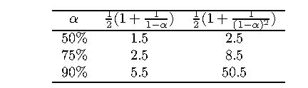
Closed Hashing
Does not work if n > m
Deletions are not efficient
Number of probes depends on load factor and collision resolution strategy.
For linear probe:
S = (½) (1+ 1/(1- α)) and U = (½) (1+ 1/(1- α)²)
As α approaches 1, number of probes increases dramatically:
Notes:
Rehashing: when table gets full, create bigger one and rehash all the data into new table.

Slide 15
B-Trees
Prestructuring

Slide 16
Indexes
Storing large number of records on a disk
Worthwhile to use extra space for faster access.
Index provides information about where record is located
Structured Dataset: record is assumed to have a key that is used to locate it.
Implemented with a B-Tree

Slide 17
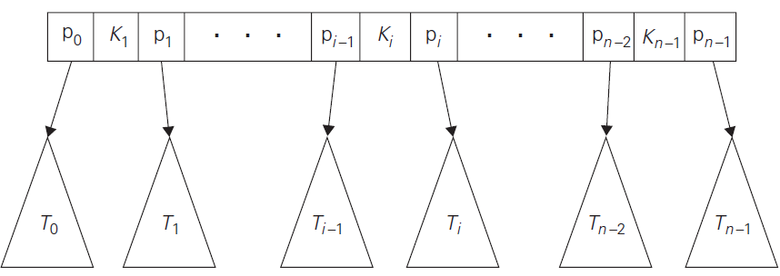
B-Trees
B-Trees are non-binary
Records stored in leaves in increasing key order.
Parental nodes used for indexing – contain n-1 ordered keys interposed with pointers to children.

Slide 18
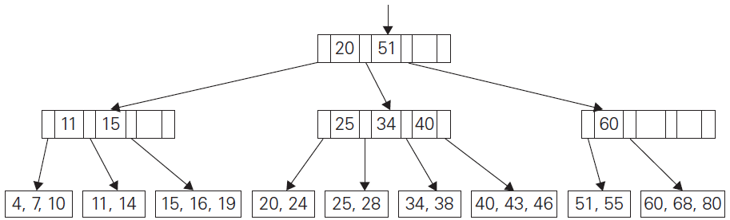
B-Tree Properties
Tree has an order m
Root is leaf or has between 2 and m children.
Internal node has between m/2 and m children.
The tree is perfectly balanced – all leaves are at same level.
Example of B-Tree
(m = 4)

Slide 19
Searching a B-Tree
Like searching a BST
If m is large, can use binary search inside a node.
Performance: more interested in disk page accesses than individual comparisons
Disk access orders of magnitude slower than key comparison.
Each node in B-Tree corresponds to a disk page
Number of page accesses = height of B-Tree

Slide 20
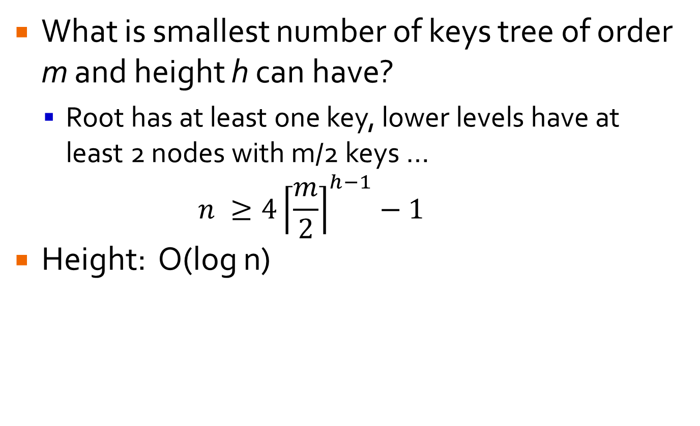
Height of B-Tree
What is smallest number of keys tree of order m and height h can have?
Root has at least one key, lower levels have at least 2 nodes with m/2 keys … $n ≥4{\left\lceil \frac{m}{2}\right\rceil }^{h−1}−1$
Height: O(log n)

Slide 21
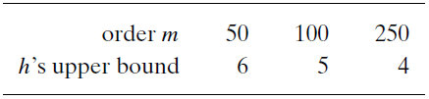
Height of B-Tree
Height: O(log n)
Given 100 million records:
In real applications, rarely exceeds 3 disk accesses
Can store root and level 1 pages in RAM to speed up.

Slide 22
Insert O(log n) – Remove Too
Search for appropriate leaf for new record’s key.
If leaf has space, place record and finished.
If not, split leaf in half:
Take larger half of keys and break into new node
Insert newly created node into old node’s parent (recursive insert)
If root splits, then create new root above and thus increase height of tree.

Slide 23
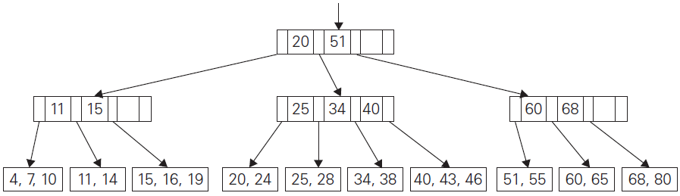
Insert O(log n)
Add 42 to tree

